Slide 1
Mrs. Phillips Patterns, Lines & quadratics II
Math Enrichment Program
WELCOME!
Day 5 Agenda:
Raffle
Warm Up
Rational vs. Irrational Numbers
Explore Functions
Summary
This session will be recorded for learning purposes. Learning purposes include: a lesson review for students who are absent, students who want to review for a test, etc.

Slide 2
Attendance Raffle Prize!
Every Monday you attend a class, I will put your name in the Attendance Raffle. At our last session together, I will draw a name to see who wins a $25 gift card to Walmart!
Attendance at all previous sessions count too!

Slide 3
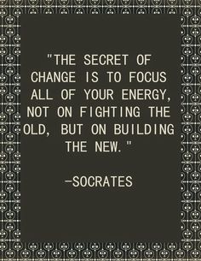
Discussions
Keep up the good work!
If you have an obstacle that you can't overcome, you need to keep trying because eventually you are going to overcome it and be a stronger person because of that. If you just give up then you will live the rest of your life wondering "what if" I had tried harder.
- Medina Sljivo
Change, to me, weather good or bad just depends on what's changing and the situation....for example I come from a small rural town in northern Kentucky, I don't like change in this situation because they've torn up farms for roads and businesses, shut down little shops putting people out of work that i personally know, and so on......I don't like that change so its bad to me, and its also bad when you let someone change you.....now if its for the better than yea its good but what I mean is if your changing to please someone or to be cool.......change is good, however, when your closing the door on past mistakes and making change to never make those mistakes again. - Jacob Becker
Notes:
Fill in your choices of discussion snips

Slide 4
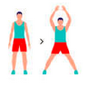
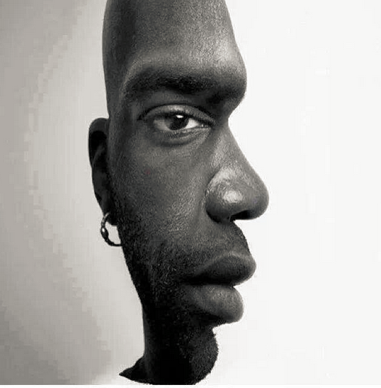
Front or side view?

Slide 5
Which line is longer?
Notes:
Both are same length -

Slide 6
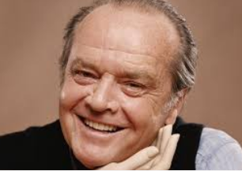
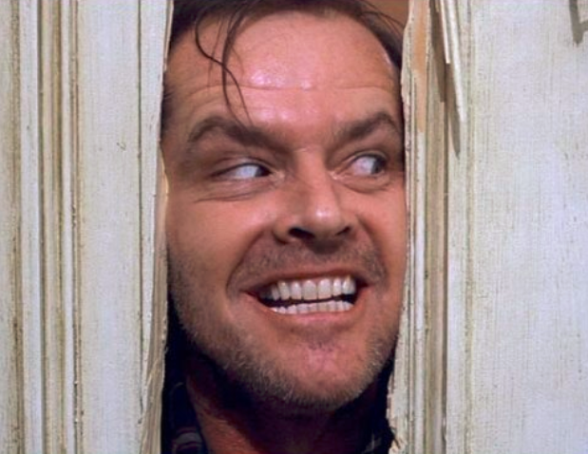
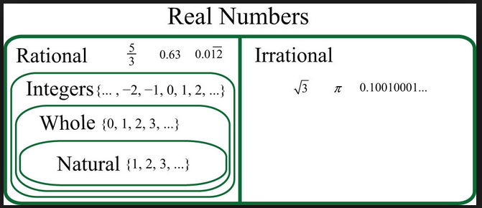
Rational vs. Irrational
Rational Numbers = A real number that can be written in the form and b is any number except 0.
Irrational Numbers = A real number that can NOT be made by dividing two integers.
Notes:
Over my dead body- home is where the heart is- see eye to eye

Slide 7
rational or Irrational?
$\sqrt{17}$
0.333333………….
$\text{22/7}$
$\sqrt{3} \sqrt{9}$
Notes:
Ask student to Circle the RATIONAL numbers

Slide 8
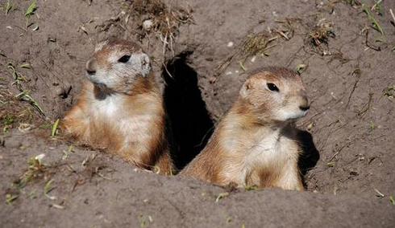
POP – up #1
1) What is the rule for f(x)
A) f(x) = -5x
B) f(x) = 2x
C) f(x) = x²
D) f(x) = 5
x | f(x)
-5 | 25
2 | 4
-2 | 4
5 | 25
9 | 81

Slide 9
POP – up #2
2) Fill in the blank,
1, 4, 16, 64, ______,1024, 4096.
A) 256
B) 81
C) 100
D) there is no pattern

Slide 10
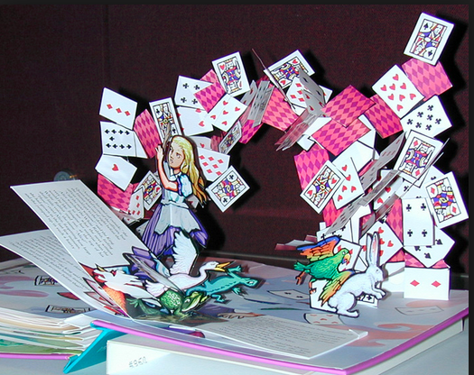
POP – up #3
For the linear function y = 2x – 5; if x = 0 , then y = ?
A) 5
B) -5
C) 2
D) can’t be found

Slide 11
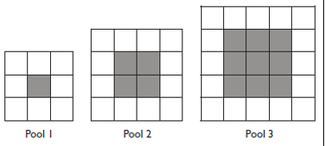
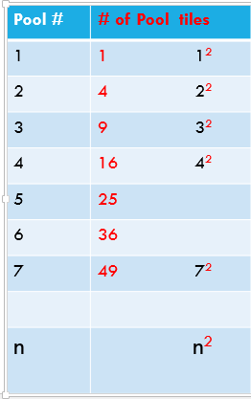
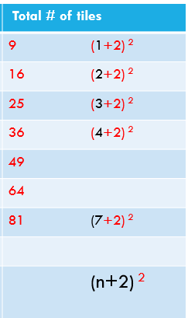
Swimming pools- data How can we find # of Walkway tiles?

Slide 12
Swimming pools- data
Pool # | # of Pool tiles | # of Walkway tiles | Total # of tiles
1 | 1 1² | 8 9-1 | 9 (1+2) ²
2 | 4 2² | 12 16-4 | 16 (2+2) ²
3 | 9 3² |  | 25 (3+2) ²
4 | 16 4² |  | 36 (4+2) ²
5 | 25 |  | 49
6 | 36 |  | 64
7 | 49 7² | 32 81-49 | 81 (7+2) ²
n | n² | (n+2) ² – n² | (n+2) ²

Slide 13
Application
Find the area of the walkway around the pool
24ft
15ft
10ft
16ft

Slide 14
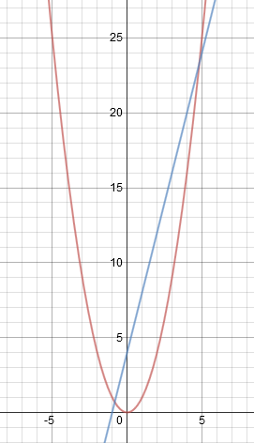
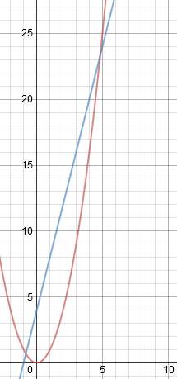
Linear vs. Quadratic
https://www.desmos.com/calculator
At which value of x does the quadratic function starts to grow faster than the linear function?”
Let’s Compare:
x | f(x) = x²
1 | 1
2 | 4
3 | 9
4 | 16
5 | 25
6 | 36
7 | 49
x | f(x) = 4x + 4
1 | 8
2 | 12
3 | 16
4 | 20
5 | 24
6 | 28
7 | 32
x²
4x + 4

Slide 15
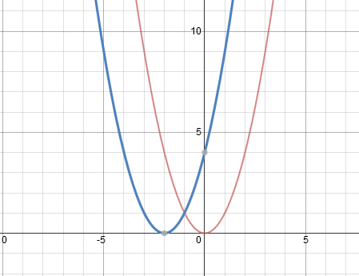
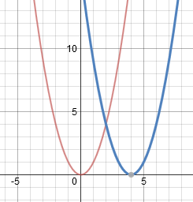
Quadratic vs. Quadratic
https://www.desmos.com/calculator
How have the graphs changed?
1.
2.
x² vs (x + 2) ²
x² vs (x - 4) ²

Slide 16
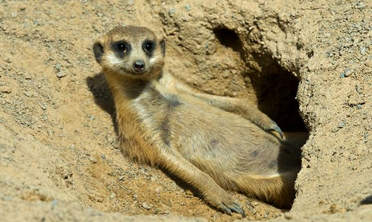
POP – up #4
4) Fill in the blank,
81, 64, 49, ____ , 25, ...
A) 45
B) 34
C) 36
D) 35

Slide 17
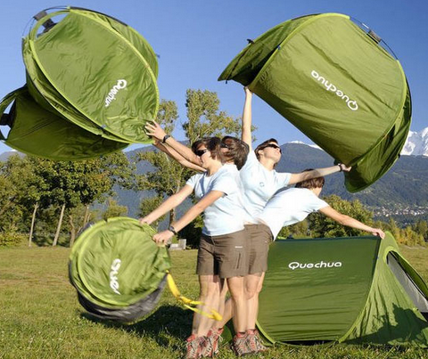
POP – up #5
5) For the linear function y = -5x + 2,
for each one unit increase in x the y-value is decreased by 5.
A) True
B) False

Slide 18
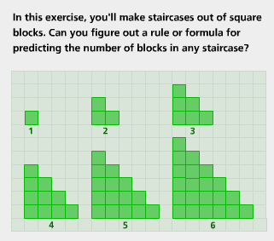
Think about Stair cases
N = pattern # | T = Total # of tiles
1
2
3
4
5
6
7
N | ?
Notes:
If time runs out just into the problem and let them know to expect a kmail with this slide

Slide 19
Snap shot
Please write on the board
Write TWO things you learned so far

